Slide 1

m
Machine Learning
F# and Accord.net

Slide 2

Alena Dzenisenka
Software architect at Luxoft Poland
Member of F# Software Foundation Board of Trustees
Researcher in the field of mathematical theoretical possible in modern programming concepts
Speaker and active software engineering community member
@lenadroid

Slide 3
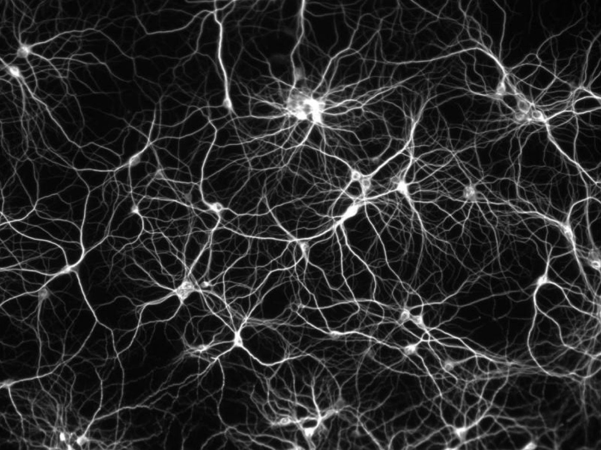
Machine Learning

Slide 4
Questions
Why machine learning?
What is the data?
How?

Slide 5
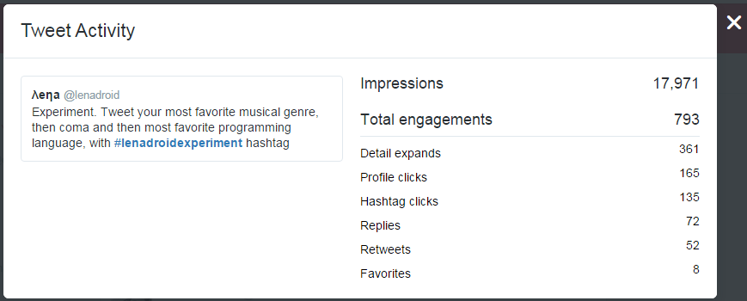
Data Questions.

Slide 6
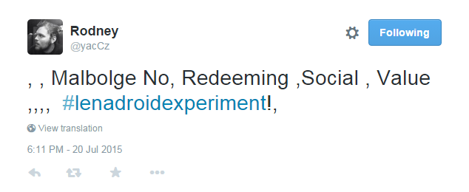
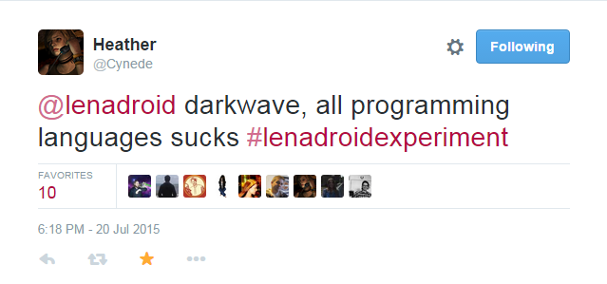
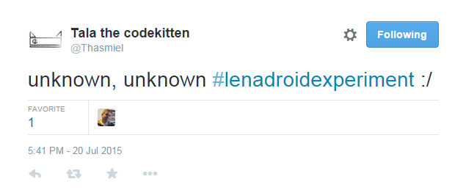
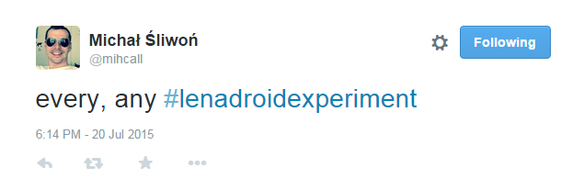
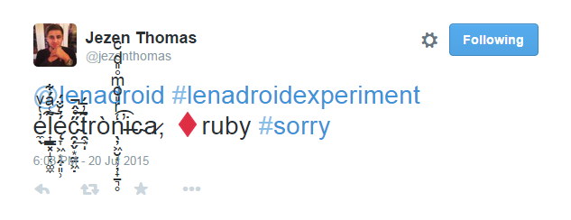
Data reality :\

Slide 7
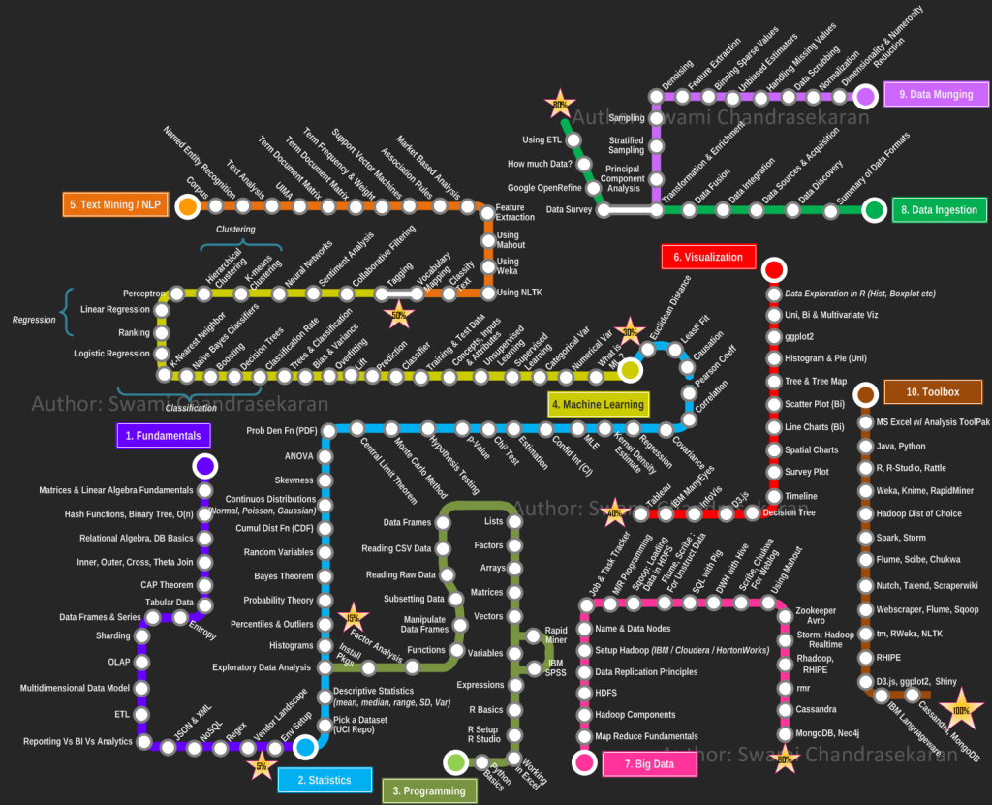
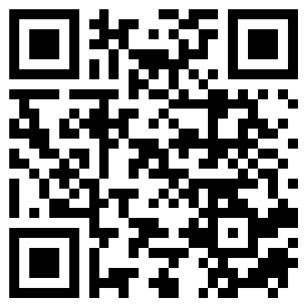
Path to grasping machine learning and data science…

Slide 8
Contents
Multiple Linear ← Regression
Logistic Regression ← Classification
Neural Networks ← Classification
K Means ← Clustering
What’s next?

Slide 9


Slide 10

F# for machine learning and data science!

Slide 11
Linear Regression
Notes:
Suppose we want to predict something
Let it be the exchange rate for some day in the future
Regression is prediction of some number from a continuous range
In supervised machine learning we always have train data (inputs and known outputs), test data (just inputs)
Inputs here can be political situation, financial conditions, weekday, working day, weather, holiday, etc.
The idea of linear regression is to find a function that will fit the training samples in the most optimal way
Here imagine that each training sample corresponds to one point in the picture
So the idea is to draw the line that would fit all points the best way.
Anyway, let’s look how linear regression works

Slide 12
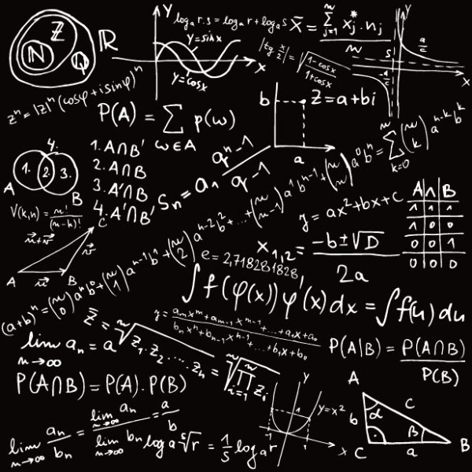
MATH
Notes:
Let’s dive into some math behind it

Slide 13
How to predict?
Make a guess.
Measure how wrong the guess is.
Fix the error.
Notes:
How can we even predict something?
Well, it’s simple.
We can make a guess, then find out what is the mistake of our guess, and after that – fix our mistake.
So, the first step is to make a guess

Slide 14
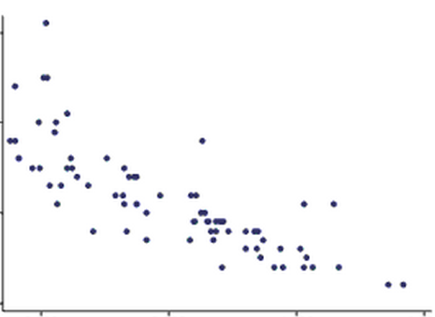
Make a guess!
Notes:
The simplest case of linear regression is when we have only one input parameter and one output parameter.
It’s as if we were about to predict the exchange rate based on only financial conditions.
Then we can locate all our training data on the 2D picture and make a guess.
That means, we are trying to draw the line that should ideally fit our data, but as it’s the guess, it is obviously wrong initially.

Slide 15
Make a guess? What does it mean?...
Hypothesis /guess :
weights
Notes:
But what it actually means… to make a guess?
Guess that we were making in the simplest case is a line.
As you know from the high school, a straight line is represented as a function f(x) = ax + b.
To draw the random guess line we need to know at least two points to draw it through.
So to make a guess literally means to choose two random points we are going to draw the line through. That is the simplest case
If we have N input parameters or predictors we’d have to think of N random values to make a guess.
This random values we’ll can theta parameters, they are also called weights.

Slide 16
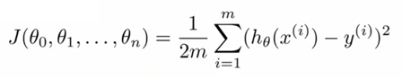
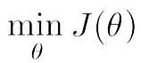
Find out our mistake…
Cost function/ Mistake function:
… and minimize it:
Notes:
Now we have training data and we have a guess that we’ve made.
Now the goal is to measure how wrong we are and what is the mistake.
How can we do it? We can, because for training data we have both inputs and already known outputs for them.
What we can do now is to send out inputs from the training set to our guess function that we’ve made and …
… to compare the output of the guess function and the actual known output that we have for the given data sample from the training set.
To compare it we are defining our COST function or MISTAKE function
It is defined as the squared error function that, for each data sample from the training data finds the difference between the guess and the output.
Basically, what the mistake function gives to us?
It shows how wrong our randomly selected weights or theta parameters are..
What are we going to do with the mistake? We want to reduce the mistake in our guess!
To reduce the mistake we should minimize our mistake function
We should find the minimum of the mistake function, so we’ll know the point where our guess is least wrong.
And why do we need this all? To find out the correct values of weights so we’ll be able to make the perfect fit for our data!

Slide 17
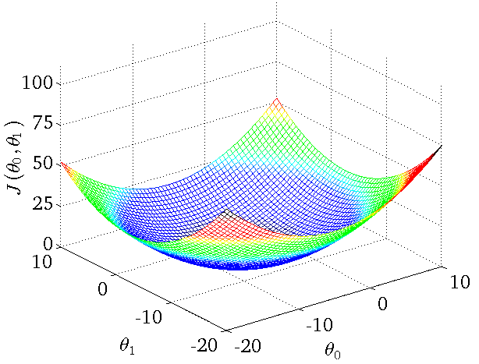
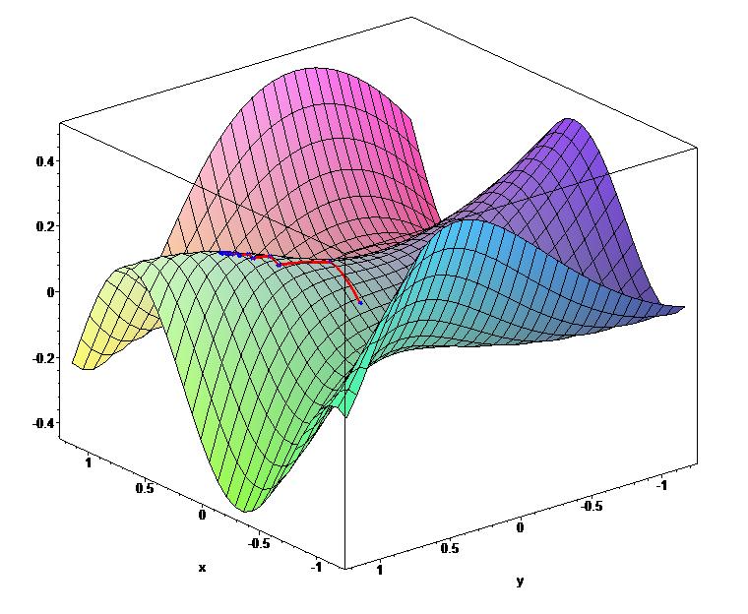
Mistake function looks like…
Global minimums
Notes:
To imagine the cost or mistake function… it can look like this..
When our initial guess theta parameters are wrong, we would be located at the random point on the shape.
When we are minimizing the mistake function, we should literally find the way from the point we are to the minimum of the function.
But how do we know where the minimum is?
First, we can find out the direction, where we should move from our point towards the minimum.
How can we find the direction? If we find the derivative of the mistake function at the point we are – it can be either positive or negative
Positive means that the tangent looks that way and minimum is on the left, so we should move left.. If it’s negative, it means minimum is on the right and we should go right
In addition to the direction of moving towards the minimum we should define the learning rate, that is the size of the step we are making.
If the step is too big then we can overjump the minimum. If it’s too small we may learn very very slowly.

Slide 18
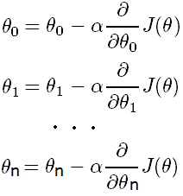
How to reduce the mistake?
Update each slope parameter until Mistake Function
minimum is reached:
Alpha
Learning rate
Derivative
Direction of moving
Simultaneously
Notes:
So, the process of moving towards the minimum until we reach it is basically the simultaneous update of all our random guess theta parameters
When we update each theta parameter we are updating it to move the direction of the minimum with the step defined by the learning rate.
Here the learning rate is alpha, and the direction is defined from the partial derivative of the mistake function for the given theta parameter.
And we are doing this iteratively until we end up at the minimum, where the derivative should be either 0, or very close to 0.

Slide 19
Fix the error
Notes:
When we have done the minimization of the mistake function that means…
That means we know the correct values for the weights or theta parameters and we can use it to finally fix out guess and draw the ideal fit.

Slide 20
Multiple Linear Regression
X [ ] – Predictors:
Statistical data about bike rentals for previous years or months.
Y – Output:
Amount of bike rentals we should expect today or some other day in the future.
* Y is not nominal, here it’s numerical continuous range.

Slide 21
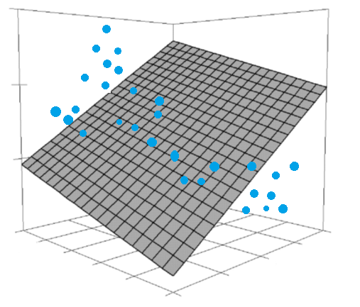
Make a guess!

Slide 22
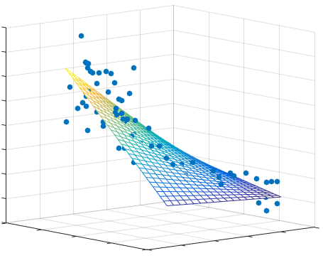
Fix the error

Slide 23
“Talk is cheap. Show me the code.”
Multiple linear regression: Bike rentals demand

Slide 24
What to remember?
Linear Regression
Simplest regression algorithm
Very fast, runs in constant time
Good at numerical data with lots of features
Output from numerical continuous range
Linear hypothesis
Uses gradient descent

Slide 25
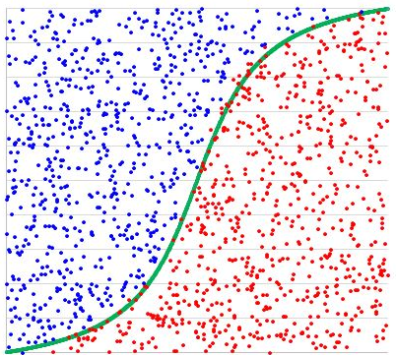
Logistic Regression
Notes:
Classification.
Output is not a number from some continuous range – output is the category (black or white, yes or no)
Logistic regression is a classification algorithm that may have only two categories on the output, so it’s binary classification

Slide 26
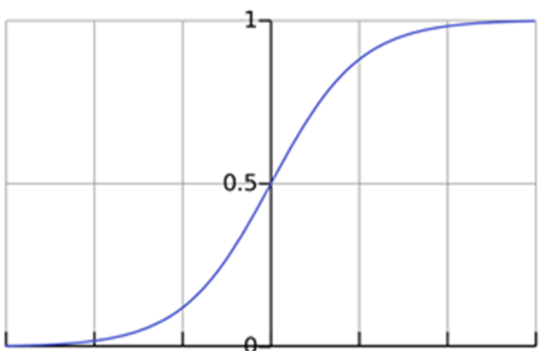
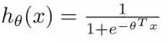
Hypothesis function
Estimated probability that Y = 1 on input X
Notes:
Here we also have our guess or hypothesis function, that is different here.
In the simplest Linear Regression it was a line, here as the outcome is categorical we have the guess function that outputs the estimated probability that the output would be equal to one for the given set of inputs.
This function is called sigmoid or logistics function.
And here we also have the set of random theta parameters or weights, that are located in the degree of e at the bottom part of the equation.

Slide 27
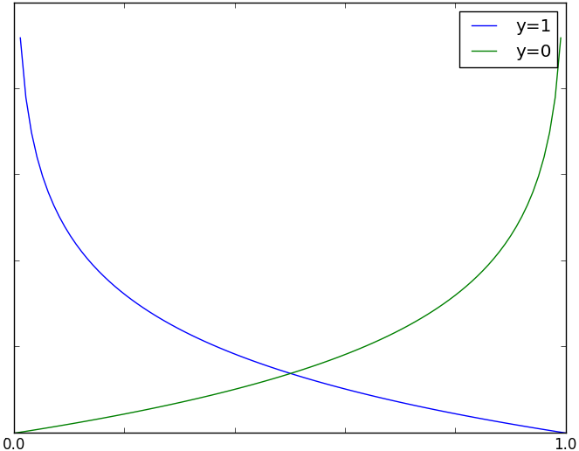
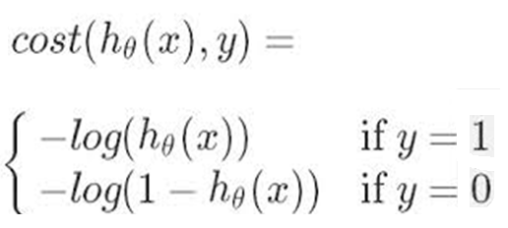
Mistake function
Mistake function is the cost for a single training data example
h(x)
Notes:
The mistake function here for each training sample can be divided into two parts.
As out outcome can be either one category or another category, so either 0 or 1 ….
…. Then, if the real outcome for the data sample of predictors is really 1, and our guess function outputs 0 – then the mistake should grow when the guess decreases
… if the real outcome is 0, and our guess is 1, which is wrong.. Then out mistake should increase as our guess value increases.
That is the mistake function for separate data samples

Slide 28
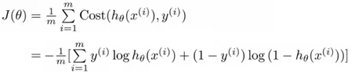
Full mistake function
1. Uses the principle of maximum likelihood estimation.
2. We minimize it same way as with Linear Regression
Notes:
The full mistake function for all data samples is just the sum.
It uses the principle of max likelihood estimation and we minimize it the same way we did with Linear Regression
After that we’ll know the correct set of theta parameters to make our guess perfect finally.

Slide 29
“Talk is cheap. Show me the code.”
Logistic Regression Classification Example

Slide 30
What to remember?
Logistic Regression
Classification algorithm
Output is the binary value, either 1 or 0
Relatively small number of predictors
Uses logistics function for hypothesis
Has the cost function that is convex
Uses gradient descent for correcting the mistake

Slide 31
At this point…

Slide 32
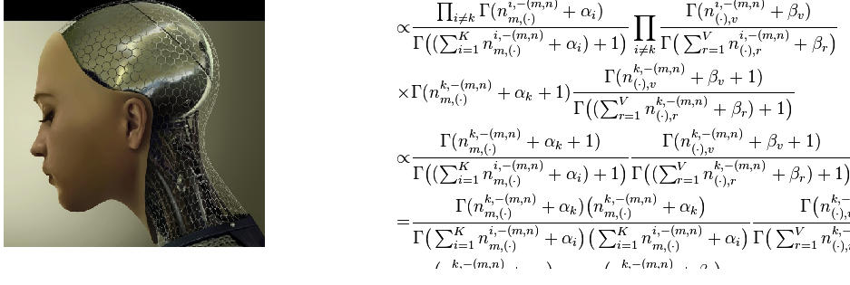
Machine Learning
What society thinks I do…
What other programmers think I do…

Slide 33
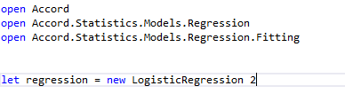
What I really do is…

Slide 34
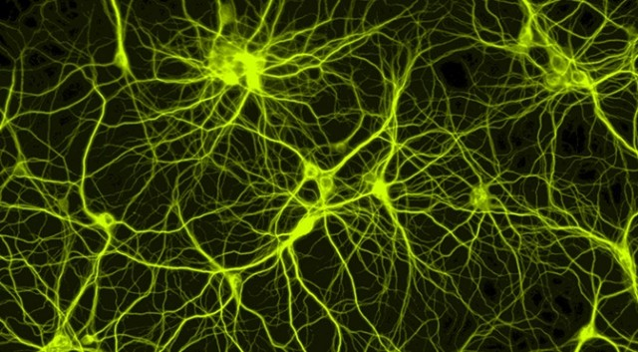
Neural Networks

Slide 35
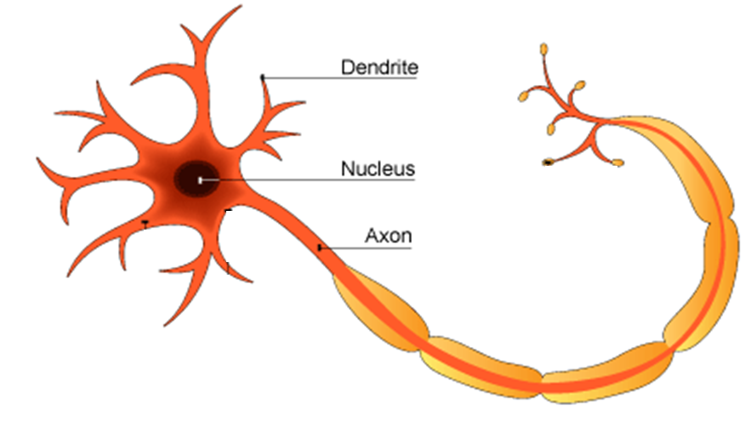
Neuron

Slide 36
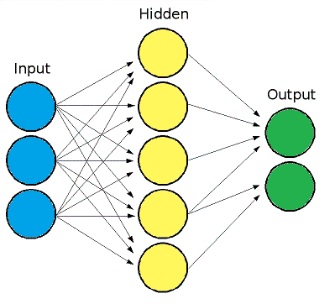
Neural Networks

Slide 37
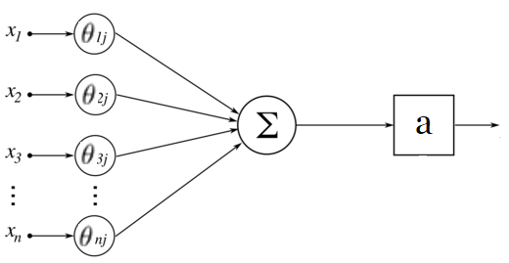
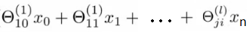
Layer transitions!
Input
Weights
Activation function
Activation unit
(value which is computed and outputted by the node)

Slide 38
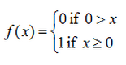
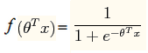
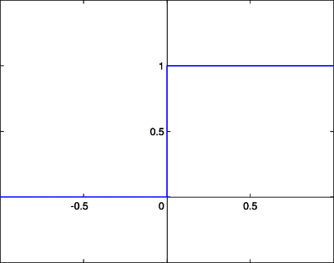
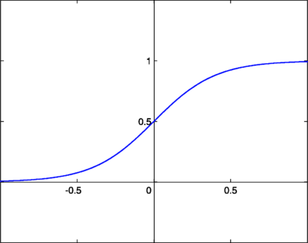
Activation function?
Step activation function
Used in binary classification
Sigmoid activation function
Uses logistic function to perform the activation

Slide 39
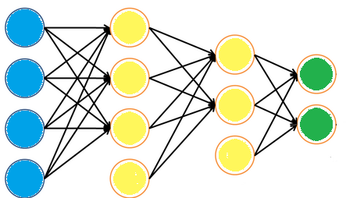
Forward propagation
X = X
X = a1
x
a
X = a2
a
x
a
Predictors
Hypothetic
Outputs!
a
x
a
a
x
a
Activation Computational Nodes!

Slide 40
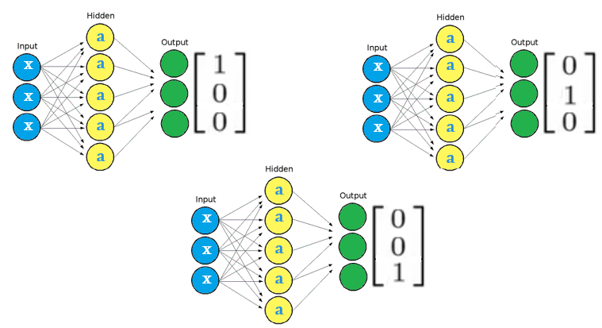
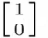
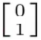
Multi class?
a
a
x
a
x
a
x
a
OR
x
a
x
a
x
a
a
a

Slide 41
Cost function?
x
x
Looks difficult? No, it’s really not so complicated…
x
Outputs the vector with size == number of output classes
Similar to Logistic Regression cost function
Finds the mistake of our hypothesis and real outputs

Slide 42
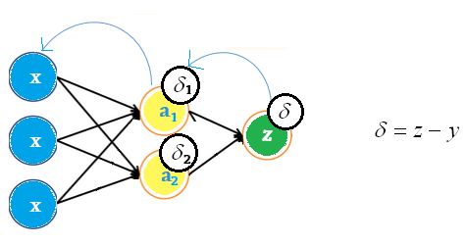
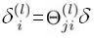
Minimize the error!
Error value
x
x
x
x
And then… recalculate weights!

Slide 43
“Talk is cheap. Show me the code.”
Neural Networks Classification Example.

Slide 44
What to remember?
Neural Networks
Extremely powerful
Slow learning / Fast prediction
Big number of predictors
Complex hierarchical relationships
No need to understand the data
Wide applications

Slide 45
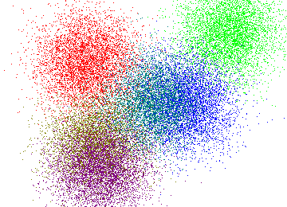
K-Means

Slide 46
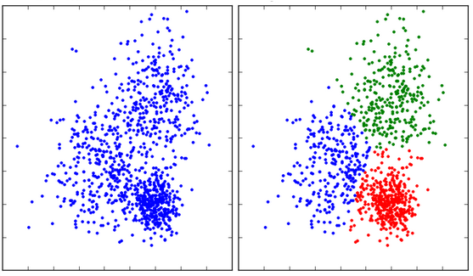
Clustering

Slide 47
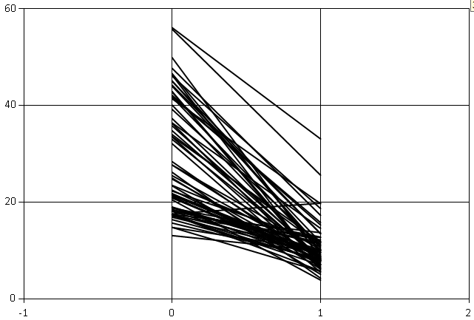
Birth-death percentage rates

Slide 48
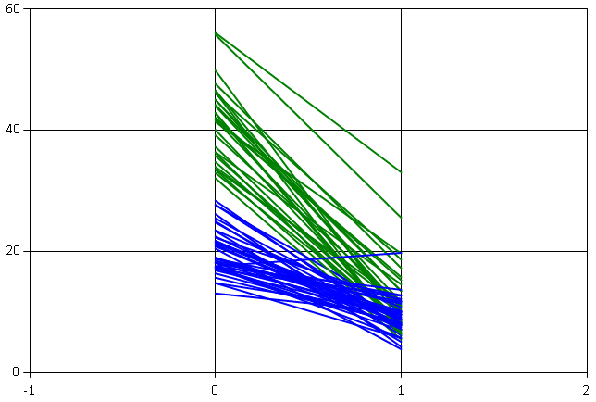
… with clustering K=2

Slide 49
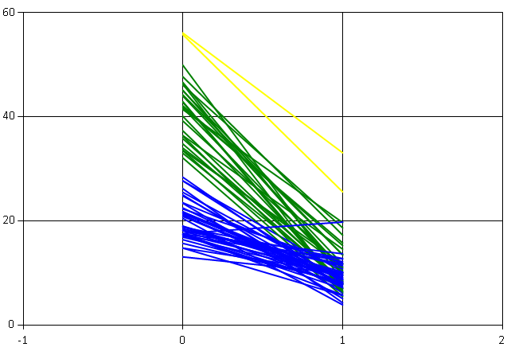
… with clustering K=3

Slide 50
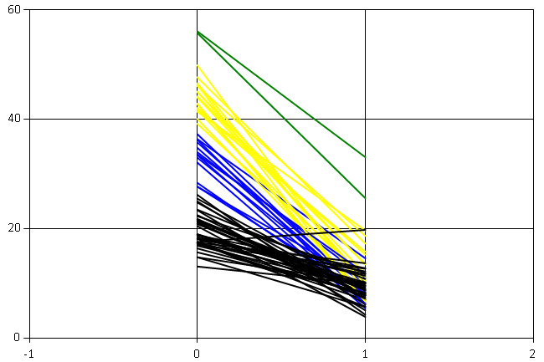
… with clustering K=4

Slide 51
What’s next?

Slide 53
I’m Lena
@lenadroid

Slide 54
Thank you!

